Slide 1
Team Vision
IIM Ahmedabad

Slide 2














Executive Summary
Executive Summary
Trends
Recommendations
Feasibility Analysis
Industry Research
Primary Research
Industry reports
Newspaper and analyst reports
CEO of top health tech startup with over 45000 doctors;
CEO API sourcing at top pharmaceutical company;
Top faculty at IIMA specializing in pharma
Trends deciphered
Envisioned GSK 2.0
Decline in drugs and vaccine sales
New trends emerging in product and supply chain
HCP-MR engagement model
Digitization of
supply chain
Tele-
medicine
Prescriptive analytics
Product offering expansion
Changing modes and requirement of interactions
Impact based implementation planning segregating recommendations
Analysis of key risks and their mitigation strategies
Analysis of financial gains resulting in an NPV of Rs. 849 Mn
1

Slide 3









Executive Summary
Trends
Recommendations
Feasibility Analysis
While there is decline in frequency of sales rep-HCP interaction post covid, there is gradual uptake of virtual mode of communication to bridge the gap
Key Insights
Mode of Interaction
With the decrease in in-person detailing, physicians are adopting the virtual mode of communication but still some are reluctant to adopt any newer means waiting for normalcy to return
Value addition/Increased assistance
With more time required for virtual interaction, physicians are looking for more meaningful interactions with sales rep expecting them to be enablers rather than sellers
Physicians prefer multi stake holder engagement in virtual interaction in the post-covid scenario
Multi Stakeholder Engagement
With the convenience that new mode offers, HCPs are looking to effectively utilize the time bringing multiple stakeholders (Sales rep, MSLs, colleagues) on the same detailing call
MSL
Nurse/Staff Members
Sales
Rep
Pre-Covid
HCP
Coordinated Approach
HCPs demand a more coordinated approach from pharma companies. Multiple emails for virtual detailing of different products is a big burden which can be minimized by a more coordinated effort
Other Personnel
Colleagues
Post-Covid
2

Slide 4



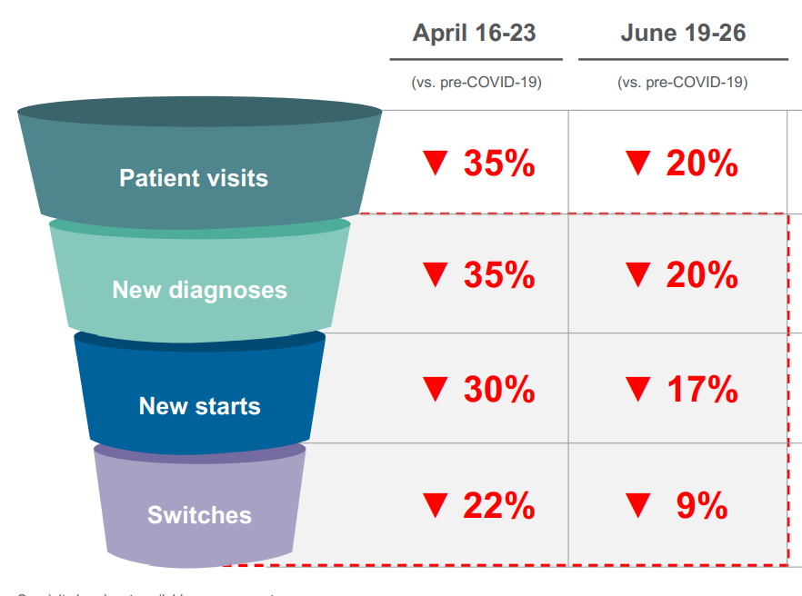



Significant decline in patient visits to hospitals and out-patient clinics leading to decline in naïve and switch patients affecting the complete patient funnel
Executive Summary
Trends
Recommendations
Feasibility Analysis
HCP
Pharmacy
Patient
Pharma Co.
Shortage of critical drugs in pharmacies due to supply shock of API, packaging material and poor demand estimation
~80% physicians have experienced a decline in patient visits
Overall pharmaceutical sales declined by ~10% in the 2 months post lockdown. Increasing trend observed towards e-pharmacy.
Pharmacy
Patient
Decline in sales/growth across drug categories
Patient
Pharma Co.
 | May’20 | June’20
Vitamins/Minerals | -9% | 6%
Anti-Diabetic | 1.10% | 8.50%
Respiratory Drugs | -6% | 4%
Anti-Infectives | -21% | -10%
Pain/Analgesics | -17% | -2%
Increasing trend towards home medical devices like pulse oximeters, glucometers, inhalers etc.
With decrease in supply, prices saw an increase of ~5%, affecting patients already reeling with credit crunch. .
Unpredictability in demand observed due to panic buying of cardiac and anti diabetic drugs. Agile supply chain required to meet future unpredictability
3

Slide 5
Executive Summary
Trends
Recommendations
Feasibility Analysis
Vaccine segment needs immediate attention due to a major dip in demand and a possible post covid spike in postponed vaccination drives.
Key Measures to keep in mind
Key Trends observed
Adult vaccines which has been almost non existent in Indian market rising in the pandemic
Agile supply chain required post covid to meet the needs of the pent up demand due to delayed immunization drives
Help HCPs in facilitating home immunization drive and make immunization affordable with insurance coverage
Postponed pediatric immunization due to fear of covid and economic hardships.
Home immunization catching up and may become a permanent trend
Vaccine portfolio of GSK was the worst affected in the pandemic due to reduced patient visit and postponed immunization drives
Deployment of health workers to covid duties have further hampered the immunization drive
A different approach needs to be adopted for general and specialized HCPs especially in the current scenario to ensure long term engagement
Specialized
Requires more information on new therapy areas, cases and drug formulation
Ideal promotion strategy would be speaker sessions and interaction with though leaders
General
Important for GSK India due to the acute disease portfolio. Traditionally more visit meant greater brand recall and more Rx due to pen habit
Ideal promotion strategy in the current scenario would be courier sampling and CSR activities
4

Slide 6



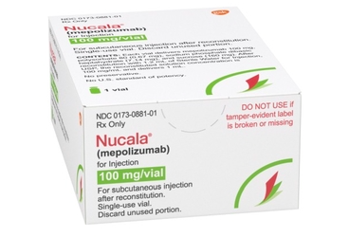
Executive Summary
Trends
Recommendations
Feasibility Analysis
Engagement model for HCP to interact with MRs and Patients in the pandemic situation
HCP-MR Engagement Model
Effect on the interaction of HCPs with Patients
Virtual Conference
Telemedicine facilities to customers with waiting room and patient queue
Virtual speaker session with thought leaders
Round table conference for doctors across countries
Patient to be able to self-schedule visits along with walk-ins
Allow multiple provider access to the same patient queue for remote load distribution
Do Uber-style load balancing and distributing patients to the first available provider
E-prescription, credit card and health record access to HCPs
Detailed molecule level information of drugs to HCPs
Interactive chatrooms for doctors to interact at anytime of convenience
KPI: Increased Participation and Feedback Readings
Sampling
Doctors
Patients to connect with the doctors online and receive advice and medicine related to their health online using the required platform
Patient
Due to pandemic patients are not able to visit doctor and prefer online way of connecting, Lack of personal touch along with
To replicate the current method of providing the drugs given generic doctors particularly rely on samples, HCPs to be provided with samples of drugs via courier so that HCPs can help patients whenever needed and good will gesture from GSK is maintained
For specification drugs like Nucala in respiratory category, GSK can introduce co-pay cards followed by drug insurance which will help GSK to further introduce drugs in respiratory and oncology therapy areas in future where co-pay cards could be used before the drug insurance starts for customers
GSK can come-up with diverse platform solutions to maximize doctor equity in new normal and reach out to tier 2,3 cities patients
KPI: Pre and Post Rx
KPI: Activity and SignUps on application
5
Notes:
Organize virtual events/speaker sessions for doctors lead by experts and thought leaders of the field to tell the doctors about the recent clinical trials of GSK drugs along with information about GSK drug portfoliot
Use the global network of doctors affiliated with GSK to help doctors interact about recent problems and solutions by holding round table conferences inviting doctors from different countries.
Provide detailed molecule level information about drugs to doctors to help them make informed decisions for patients

Slide 7
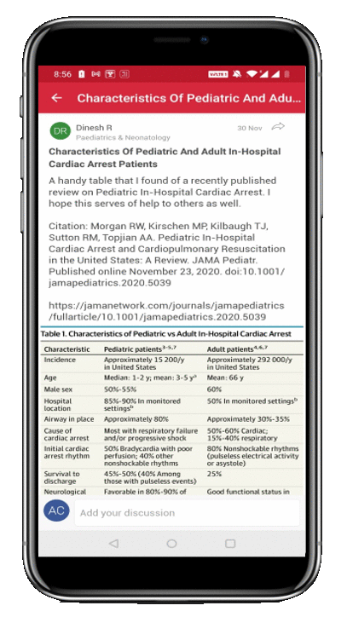





Executive Summary
Trends
Recommendations
Feasibility Analysis
GSK can use the opportunity of shift towards digital use in starting to building capabilities for long term disruptive innovations
Prescriptive Analytics
(Sales Reps’ virtual manager)
Application
Key metrics
HCP rating of sales rep
Reps’ satisfaction rating of the call
Molecule level information for drugs
Connecting doctors across the globe. Easy virtual connect
Key Features
Record of HCP attributes (prescriptions, no. of calls and samples made, demographics and specialty)
Record of call details (text transcript including time of call and major concerns flagged)
Key Features
Personalised recommendations based on HCP attribute and call transcript on what the HCP likes to be talked about (drug efficacy, prices, formulations, clinical trials etc)
Community to share new cases and clinical research
Chatbot to help doctors with general concerns
KPI: Pre and post Rx of the HCP (Beta Testing)
KPI: HCP registration and engagement
6

Slide 8











Executive Summary
Trends
Recommendations
Feasibility Analysis
Digitize supply chain to prevent stock outs and increase visibility on demand
Pharmaceuticals Supply Chain – Digitization response
Online Pharmacy
KPIs: tracking stock outs, operational costs, tracking inventory days
Manage multiple suppliers through the multi-tier chain
Implement ERP to assess real-time inventory on each leg
Stress test the supply chain, through forecasting capabilities
Buy directly from company
Allow the pharmacy to go to the customer
!
!
Tier-2
Supplier
Tier-1
Supplier
Manufacturing plant
Warehousing
C&FA
Distributor
Eliminate multiple levels: With online pharmacies like Pharmeasy, 1mgd; pharma companies can open a D2C channel eliminating redundancies
General pharmacies, care homes, pharmacy, charities, and hospitals
Supplier platforms and spend analytics help manage multiple supplier while controlling costs
Geo-analytics based network optimization, warehousing automation to reduce cost and human intervention
Demand driven SCM, predictive analytics and enhanced connectivity improve responsiveness and prevent stock outs
Demand centric: Lean supply chain and demand centric operations would enable lower inventory, higher sales and lower stock outs
Going beyond the pharmaceutical industry
Investment Distribution
The Pharma industry in India shows clear potential of improvement which is brought out both by FMCG sector and in global practises
231
Pharma Average (India)
70%
20%
10%
133
Best in Pharma (Global)
Digital foundation – mature technologies
Digital innovation – developing technologies
Digital edge – early stage disruptive technologies
Inventory Days
117
FMCG Average (India)
83
Best in FMCG (Global)
7

Slide 9
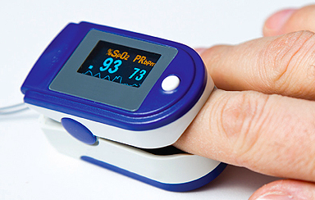
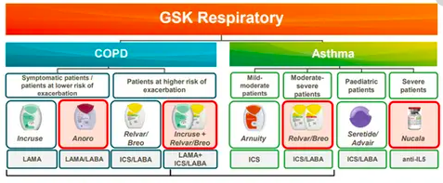
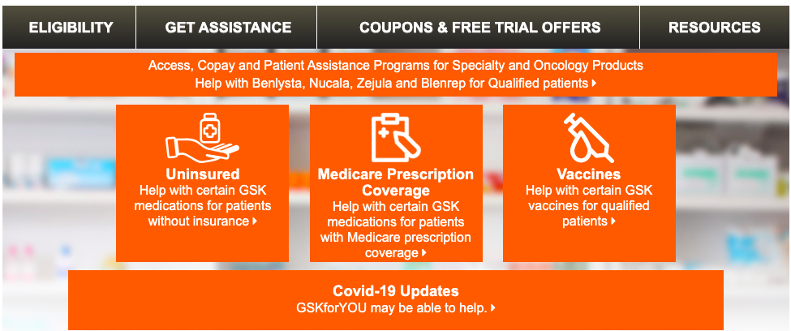
Reinventing patient-pharmacy level interaction by expanding product portfolio, business diversification and development of D2C application
Executive Summary
Trends
Recommendations
Feasibility Analysis
Product Additions
With reduced hospital and outpatient visits, there is an uptake in home medical devices. Post-Covid, sale of pulse oximeters surged 15 times and that of glucometers increased by almost 90 percent in online pharmacy. With medical devices being the fastest growing segment in healthcare segment, there is potential in becoming a household brand by entering to home medical devices space.
Medical devices can be bundled with medicines and sold in the market by either partnering with firms manufacturing medical devices or manufacturing themselves
Product Expansion
Expand portfolio by bringing in healthcare chronic medicines only available abroad to India basis the demand, especially drugs related to respiratory therapeutic area which are expected to be high in demand due to pandemic situation. Expansion of Oncology therapy area based dugs given increase in medical tourism in USA for treatments for Indian patients
Expanding Indian portfolio by including oncology and respiratory based drugs given the marketing trend
Business Diversification
Given the expansion of drugs in the Indian portfolio in the respiratory and oncology space and drugs being expensive, GSK needs to ensure that Indian consumers are able to buy the drug by mechanisms like Co-pay cards and Drug insurance schemes in place which will reduce the burden from the patients
Expanding Indian portfolio by including oncology and respiratory based drugs given the marketing trend
8

Slide 10





Recommendation analysis and financial implications
Executive Summary
Trends
Recommendations
Feasibility Analysis
Implementation and Impact
Changing interactions
High
Long term
HCPs
Short term
6
4
1
1
2
Reorient product portfolio to include med devices
Digitize supply chain becoming demand driven
MR and HCPs virtual engagement model
Pharma-ceutical company
5
High
6
4
3
Patient
Pharmacy
Impact of initiative
3
2
5
Online Pharmacy enabling direct delivery of drugs
Tele medicine and virtual consultation
Expand business into providing drug insurance to ease credit crunch
The recommendations are focused on leveraging the changing interactions between the different entities
Internalize the new normal
5
System and Tools developed to enhance Team work
People and Capability focus on perform-ance and innocation
Proce-sses promote accountability and trans-parency
Structure
Move away from silos and promote collabora-tion
Provide PPEs to patients visiting HCPs showcasing trust
Low
Ease of implementation
9
Low

Slide 11
Key risks and financial implications
Executive Summary
Trends
Recommendations
Feasibility Analysis
Key risks and mitigation strategies
Risk assessment
Potential Risks | Mitigation Strategies
Increased regulation around online pharmacies and pushback from current retail pharmacies | Early entry and consolidation of market, focus on rural reach and business diversification
Slow adoption of digitization in the supply chain and lack of coherence | Stress on values of development and team work pushing innovation driven culture
Hassle in adoption of digital platforms by doctors, may simply resort to use of common VC platforms | Rolling out incentives to use platform and personalized marketing
Leakage/Breach of confidential data of patients or doctors | Apart from data security, having a BCP for any data breach
Increased workload for medical representatives with digital engagement | Provide training programs and digital empowerment to medical reps
High
3
4
1
2
2
Probability of Impact
5
3
Additional vigilance
4
1
5
Low
Potential Cost of Impact
High
Financial Projections
Highlights
Key Assumptions
Key Metrics
Growth in EBITDA supported by 0.34% additional growth in top line and improvement of 0.58% to the bottom line.
Savings accrue even after 2 years as the industry settles into a new normal.
-The investments give results in same year of implementation
-No drastic development in the pandemic situation for 2 years
-No regulatory issues in implementing recommendation
-Savings to accrue for 5 years
NPV¹ – Rs. 849M
IRR – 44%
Savings for 2 years²– Rs.533M
10
Note 1: measured on incremental savings on EBITDA
2- Absolute values on EBITDA, not discounted over time

Slide 12
Thank You

Slide 13
Q & A

